Slide 1
CLASS NAME: REPORT WRITING &
COMMUNICATION
CLASS CATEGORY: COMMUNICATION
CREDIT HOURS 3
CLASS NUMBER: CP-22-00111
INSTRUCTOR NUMBER: 119
INSTRUCTOR: KEN LaBelle

Slide 2
WHY ARE WE HERE?
BETTER CLARITY
CLEARER DIRECTIONS
LESS MISUNDERSTANDING

Slide 3
MR DUCKS
MR NOT
OSAR
C DM WANGS
LIB
MR DUCKS

Slide 4
I will seek and I will find you.
I shall take you to bed and have my way with you.
I will make you ache, shake, and sweat until you moan and groan.
I will make you beg for mercy,
You will beg me to stop.
I will exhaust you to the point that you will be relieved when I'm finished with you.
And, when I am finished, you will be weak for days.
What am I
The Flu

Slide 5
REDUNDANCIES
LOOK FOR WAYS TO DROP WORDS
WITHOUT CHANGING THE MEANING

Slide 6
Daniel is now employed at a rehabilitation
center working as a physical therapist.
Daniel works at a rehabilitation
center as a physical therapist.

Slide 7
EMPTY OR INFLATED PHARASES
We will file the appropriate papers in the
event that we are unable to meet the deadlines.
We will file the appropriate papers if
we are unable to meet the deadlines.

Slide 8
EMPTY OR INFLATED PHARASES
INFLATED CONCISE
ALONG THE LINES OF LIKE
AT THE PRESENT TIME NOW,
CURRENTLY
BECAUSE OF THE
FACT THAT BECAUSE

Slide 9
EMPTY OR INFLATED PHARASES
INFLATED CONCISE
BY MEANS OF
BY
DUE TO THE FACT THAT
BECAUSE
FOR THE REASON THAT
BECAUSE

Slide 10
EMPTY OR INFLATED PHARASES
INFLATED CONCISE
IN ORDER TO
TO
IN SPITE OF THE
FACT THAT
ALTHOUGH,
THOUGH
IN THE EVENT THAT
IF
UNTIL SUCH TIME AS
UNTIL

Slide 11
ADD NEED WORDS
DO NOT OMIT WORDS NECESSARY
FOR COMPLETENESS

Slide 12
ADD NEED WORDS
I HAVE NEVER AND NEVER
WILL ACCEPT A BRIBE.
I HAVE NEVER ACCEPTED AND
NEVER WILL ACCEPT A BRIBE.

Slide 13
MODIFIERS
MODIFIERS SHOULD POINT CLEARLY
TO THE WORDS THEY MODIFY.
AS A RULE WORDS SHOULD
BE KEPT TOGETHER.

Slide 14
MODIFIERS
THE ROBBER WAS DESCRIBED AS A SIX
FOOT-TALL MAN WITH A MUSTACHE
WEIGHTING 150 POUNDS

Slide 15
MODIFIERS
THE ROBBER WAS DESCRIBED AS
150 POUNDS, A SIX FOOT-TALL MAN
WITH A MUSTACHE.

Slide 16
APPROPRIATE VOICE
VOICE IS A GRAMMATICAL TERM
WHICH IS USED TO TELL IF ACTION IS
BEING RECEIVED OR ACTING

Slide 17
ACTIVE & PASSIVE VOICE

Slide 18
ACTIVE VOICE
MORE FORCEFUL
SIMPLER & MORE DIRECT
CAN BE HARSH

Slide 19
PASSIVE VOICE
USUALLY WORDIER
OFTEN RESULTS IN
ROUND ABOUT WRITING
CAN BE AWKWARD

Slide 20
JARGON
USE ONLY WHEN YOUR READERS
WILL BE FAMILIAR WITH THE WORDS
SOME FROMS OF JARGON
INCLUDES PUFFED WORDS

Slide 21
PUFFED WORDS ARE WORDS
DESIGNED TO IMPRESS

Slide 22
PUFFED WORDS ARE WORDS
Vs.
COMMENCE
BEGIN
COMPONENTS
PARTS
TRY
ENDEAVOR
EXIT
LEAVE

Slide 23
PUFFED WORDS ARE WORDS
Vs.
PRIOR TO
BEFORE
PRIORITIZE
SET PRIORITIES
UTILIZE
USE
VIABLE
WORKABLE

Slide 24
PUFFED WORDS ARE WORDS
Vs.
FACILITATE
HELP
FACTOR
CONSIDERATION,
CAUSE
FINALIZE
FINISH
IMPACT ON
AFFECT

Slide 25
PUFFED WORDS ARE WORDS
Vs.
INDICATOR
SIGN
INPUT
ADVISE
OPTIMAL
BEST
PARAMETERS
BOUNDARIES

Slide 26
SEXIST LANGUAGE
AVOID STEROTYPICAL THINKING
AVOID MAN WORDS

Slide 27
STEREOTYPICAL MANWORDS
INAPPROPRIATE APPROPRIATE
CHAIRMAN
CHAIRPERSON,
CHAIR
CONGRESSMAN
REPRESENTIVE,
LEGISTOR
FIREMAN
FIREFIGHTER

Slide 28
STEREOTYPICAL MANWORDS
INAPPROPRIATE APPROPRIATE
MANKIND
PEOPLE, HUMANS
TO OPERATE,
TO STAFF
TO MAN
WORKMAN
WORKER,
LABORER

Slide 29
GRAMMAR

Slide 30
A SENTENCE IS
A sentence is the largest independent unit of grammar: it begins with a capital letter and ends with a period, question mark, or exclamation point.

Slide 31
FRAGMENTED CLAUSES
A FRAGMENTED CLAUSE IS LIKE
A SMALL SENTENCE
USALLY THEY HAVE WORDS LIKE

Slide 32
AFTER
BECAUSE
UNLESS
BEFORE
UNTIL
IF
WHEN
SO
WHERE
THAT
WHO
THROUGH
WHICH

Slide 33
Jane will address the problem of limited
on-campus parking. If she is elected special
student adviser.
Jane will address the problem of limited
on-campus parking, if she is elected
special student adviser.

Slide 34
RUN ON SENTENCES
THERE ARE TWO TYPES
OF RUN-ON SENTENCES

Slide 35
NO PUNCTUATIONS MARKS
My car is out of gas we cannot reach town before dark

Slide 36
COMMA SPLICES
This has been a very dry summer, therefore, the supply of water in the reservoirs is low

Slide 37
COMMA SPLICES
USALLY HAVE ONE OF
SIX WORD WITH THEM
AND,
YET,
BUT,
FOR,
OR,
SO,

Slide 38
TO CORRECT RUN-ON SENTENCES
USE A COMMA
USE A SEMICOLON (or, colon or a dash)
MAKING IT INTO SEPRATE SENTENCES
RE-WRITE THE SENTENCE

Slide 39
DO NOT USE COMMAS UNLESS
YOU HAVE A GOOD REASON

Slide 40
RULES FOR COMMAS
to separate the elements in a series (three or more things), including the last two.
"He hit the ball, dropped the bat, and ran to first base."

Slide 41
RULES FOR COMMAS
to connect two independent clauses
(and, but, for, nor, yet, or, so)
"He hit the ball well, but he ran toward third base."

Slide 42
RULES FOR COMMAS
to set off introductory elements
Running toward third base, he suddenly realized how stupid he looked

Slide 43
PUNCTUATION

Slide 44
THE APOSTROPHE
‘
IS USED TO INDICATE POSSESSION
OR
FOR CONTRACTIONS

Slide 45
THE EXCLAMATION POINT
!
USE TO HIGHLIGHT A
EXCEPTIONAL FEELING
USE FOR SPECIAL EMPHASIS

Slide 46
THE ELLIPSIS MARK
…
USE THE ELLIPSIS MARK TO
INDICATE THAT YOU HAVE
DELETED MATERIAL FROM
AN OTHER WISE WORD FOR
WORD QUOATION.

Slide 47
MECHANICS

Slide 48
CAPITALIZATION
CAUTION
CAPITALIZE DOES NOT
TO MAKE THEM MORE
IMPORTANT

Slide 49
CAPITALIZATION
PROPER NOUNS
NAME OF SPECIFIC
PLACES
PERSONS
THINGS

Slide 50
CAPITALIZATION
PROPER NOUNS
MONTHS
HOILDAYS
DAYS OF THE WEEK

Slide 51
CAPITALIZATION
ABBREVIATIONS
DEPARTMENTS AND AGENCIES
OF GOVERNMENT, CORPORATIONS
AND OTHER ORGAINZATIONS

Slide 52
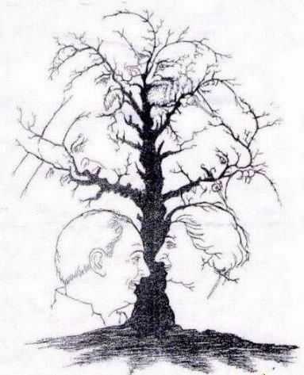
ABBREVIATIONS

Slide 53
ABBREVIATIONS
USE ONLY WHEN CLEARLY APPROPRIATE
USE STANDARD APPROPRIATE
ABBREVIATIONS
Mr. JR.
Ms. Ph.D.
Dr. M.D.
Rev. M.A.
Prof. C.B.O.

Slide 54
ABBREVIATIONS
INAPPROPRIATE
IN FORMAL WRITING
DO NOT ABBREVIATE
UNITS OF MESSURE
DAYS OF THE WEEK
HOILDAYS
MONTHS

Slide 55
NUMBERS
SPELL OUT NUMBERS
WITH ONE OR TWO WORDS
FIGURES THAT NEED MORE THAN
TWO WORDS USE NUMBERS
EXCEPTION IF A SENTENCE
STARTS A NUMBER

Slide 56
SPELLING
MANY PEOPLE FEEL THAY CANNOT SPELL
THEY EQUAITE SPELLING
WITH INTELLIGENTS

Slide 57
SPELLING
MISSPELLING IS OFTEN THE RESULT
OF INCORRECT PRONUNCIATION
INCORRECT CORRECT
CONGRADULATIONS
CONGRATULATIONS
DISCRIBE
DESCRIBE
GOVERNMENT
GOVERNMENT
ENVIROMENT
ENVIRONMENT
SECATARY
SECRETARY

Slide 58
SPELLING
INCORRECT CORRECT
PROCEDE
PROCEED
RECIEPT
RECEIPT

Slide 59
SPELLING
WAYS TO CORRECT SPELLING
BOOKS ON SPELLING
ELECTRONITS
WORD PROCESSERS

Slide 61
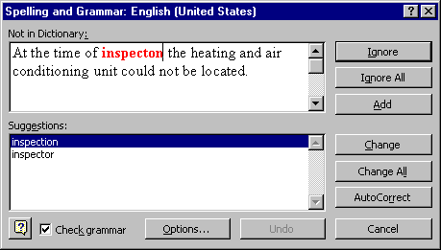

Slide 62
WRITING STYLES

Slide 63
APA AND MLA
AMERICAN PSYCHOLOGICAL ASSOCIATION
(APA)
and
MORDEN LANGUAGE ASSOCIATION

Slide 64
APA IS THE MOST COMMON
FOR BUSINESS USE
IS VERY SPECIFIC IN IT’S REQUIREMENTS
HAS REQUIREMENTS FOR EVERYTHING
EVEN THE WEIGHT OF THE PAPER

Slide 65
MLA IS CONSIDERED LESS FORMAL
COMMON STYLE FOR NEWSPAPERS
HAS LESS SPECIFIC REQUIREMENTS
DOES REQUIRE A TITLE

Slide 66
COMMON DIFFERANCES
MLA APA
MARGIANS
1” - 1 1/2” 1”

Slide 67
COMMON DIFFERANCES
PUNCTUATION
MLA APA
LEAVE 1 SPACE
AFTER WORDS,
COMMAS ECT.
LEAVE 1 SPACE
AFTER ALL
PUNCTUATION
AND WORDS
WORD, WORD
WORD , WORD

Slide 68
WRITING STYLE
THE RHETORICAL SITUATION
FIVE FACTORS THAT INFLUENCE
YOUR WRITING
1) THE OCCASION
2) THE PURPOSE
3) THE TOPIC
4) THE READER
5) YOU

Slide 69
BASIC TIPS FOR WRITING
DRAFTING
REVISING / EDITING
PROOFREADING

Slide 70
BASIC TIPS FOR WRITING
DRAFTING
OVERVIEW
PRE-WRITING
EXPLORING NEW IDEAS

Slide 71
BASIC TIPS FOR WRITING
REVISING EDITING
TO BE DONE AFTER DRAFTING
THE MORE IMPORTANT THE WRITING
THE MORE IT NEEDS TO BE REVISED

Slide 72
BASIC TIPS FOR WRITING
EDITING
ARE THE SENTENCES CLEAR
DO THE SENTENCES MAKE SENSE
DOES A SENTENCE SEEM TO RAMBLE

Slide 73
BASIC TIPS FOR WRITING
EDITING
DOES THE SENTENCE READ SMOOTHLY
IS THE SENTENCE TOO LONG
ARE KEY POINTS AND WORDS CLEAR

Slide 74
BASIC TIPS FOR WRITING
PROOFREADING
NO WRITING SHOULD BE CONSIDERED
COMPLETE UNTIL IT HAS CAREFULLY
PROOFREAD

Slide 75
BASIC TIPS FOR WRITING
PROOFREADING
READ THE PAPER OUT LOUD
ALWAYS TRY TO WAIT A DAY
USE THE COMPUTER

Slide 76
BASIC TIPS FOR WRITING
PROOFREADING
IF HIGH PROFILE
HIRE A PROFESSIONAL EDITOR
ASK SOME ELSE

Slide 77
EMAIL
EMAIL IS NOT PRIVATE
BECAREFUL OF REPLIES
BE CAREFUL OF JOKING
WATCH FOR ALL CAPS
USE THE SUBJECT LINE

Slide 78
EMAIL
EMAIL IS NOT PRIVATE
HOW EMAIL WORKS

Slide 79
OFFICE SERVER
YOUR COMPUTER
EMAIL SERVERS
SPAM
RECEIVING SERVERS
EMAIL SERVERS
BACKUPS
RECEIVING EMAIL SERVERS
RECEIVING OFFICE SERVER
SPAM
RECEIVING EMAIL SERVERS BACKUPS
RECEIVER COMPUTER

Slide 80
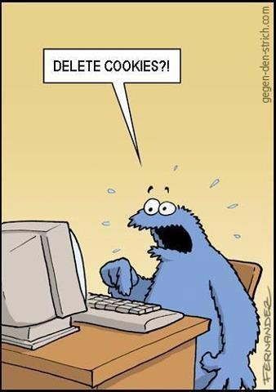

Slide 81
OFFICE SERVER
YOUR COMPUTER
EMAIL SERVERS
SPAM
RECEIVING SERVERS
EMAIL SERVERS
BACKUPS
RECEIVING EMAIL SERVERS
RECEIVING OFFICE SERVER
SPAM
RECEIVING EMAIL SERVERS BACKUPS
RECEIVER COMPUTER

Slide 82
EMAIL
BECAREFUL OF REPLIES
BE CAREFUL OF JOKING
USE THE SUBJECT LINE

Slide 83
EMAIL
G-MAIL, YAHOO MAIL, AOL MAIL… ECT.
DATA MINING

Slide 84
TEXTING
UR PHONE
UR CARRIER
UR CARRIER SERVER’S
CLOUD
RECEIVERS PHONE
RECEIVERS SERVER’S

Slide 85
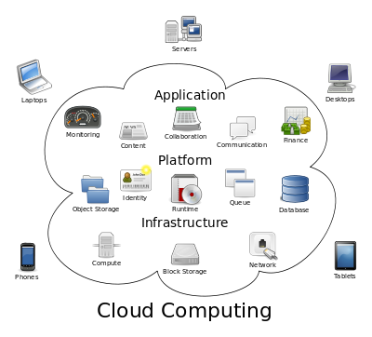
CLOUD

Slide 86
QUESTION?

